Slide 1

Assignment 4 EPPS 6354
Prattasha Nawar Islam

Slide 2
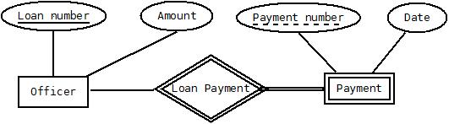
Question 1
An entity set is a set of entities of the same type that share the same properties, or attributes.
A weak entity set is one whose existence is dependent on another entity set, called its identifying entity set;
An entity set that is not a weak entity set is termed a strong entity set.
Example: In a loan payment database, payment can be the weak entity set where the loan payment can be the identifying set and payment number is the partial key.

Slide 3
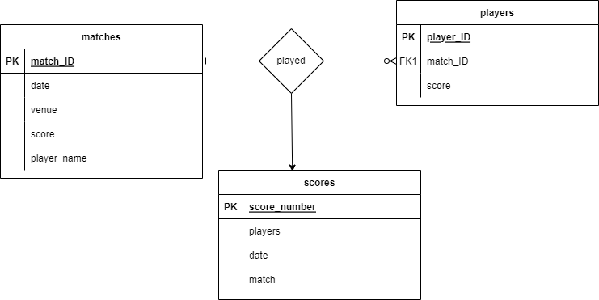
Question 2

Slide 4
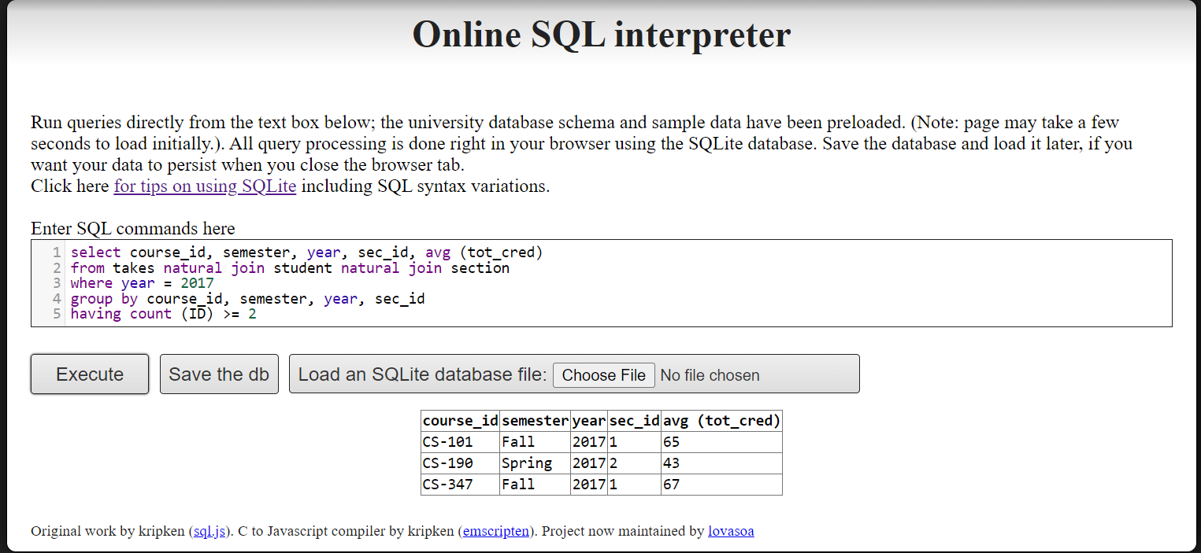
Question 3a
Because the natural join function joins through all columns with the same names

Slide 5
Question 3b

Slide 6
Question 3c

